Slide 1
Basics of IoT
Petteri Mäkelä
Seinäjoki University of Applied Sciences

Slide 2
Basics of IoT
Material
https://github.com/SeAMKedu/measurements_iot

Slide 3
Target of the lessons
The aim of today’s lessons is to create a simple web application that displays measurement data collected from a device
The web application consists of the following parts:
Server-side program (backend), which receives the measurements and sends them to a web page.
HTML page made with Google charts, which shows the measurement data in graphical form
A Python program, which simulates the device making the measurements (for example Raspberry Pi)
The server-side program will be implemented with Python Flask. Other alternatives could be Node.js, Java Spring Boot, ASP.Net, etc.

Slide 4
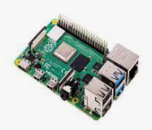
The IoT system
MQTT
Thingspeak InfluxDB
HTTP
HTTP POST
Server
(Python Flask)
HTTP GET
Client (browser)
Simulator

